Slide 1
MindGames
Project Breakdown
Brandon Knotek (bk11@hood.edu) Walid Muhammad (wm5@hood.edu) Jack Wilder (jmw38@hood.edu)

Slide 2
Our Goal
To explore the viability of neurofeedback as a means for controlling real-time interactive experiences

Slide 3
Our Goal
To explore the viability of neurofeedback as a means for controlling real-time interactive experiences
In other words, play a game just by thinking commands; no mouse and keyboard required!

Slide 4
Why Bother?
Accessibility - Physical disabilities may limit use of traditional input methods
Communication - Certain conditions make movement and speech impossible (Locked In Syndrome)

Slide 5
So How Does It Work?
Brain activity is recorded and sent to a computer using special hardware
The computer processes the activity and translates it to commands
The commands are sent to the target software and executed

Slide 6
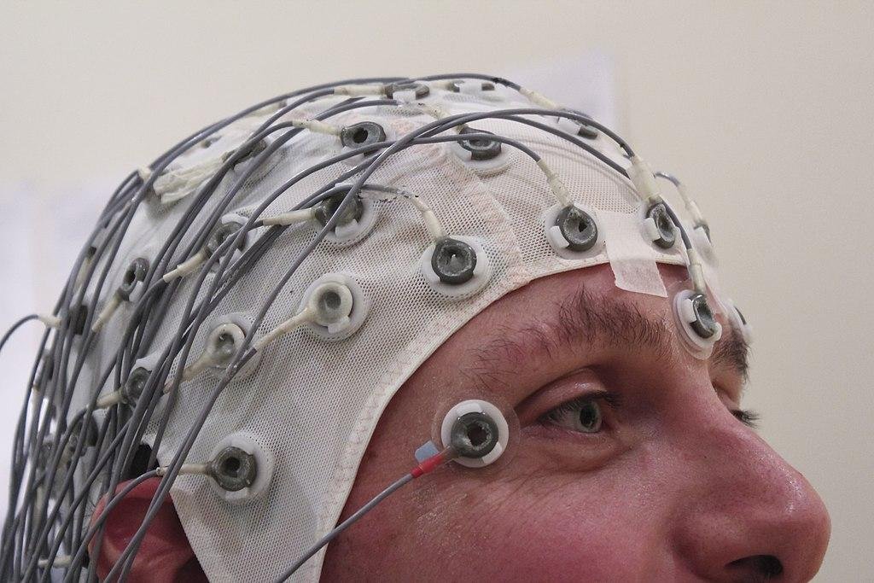
Unraveling the Brain
All brain activity is electrical
Electroencephalography (EEG) uses electrodes placed on the scalp to measure this activity
Figure 1 - An example of EEG hardware

Slide 7
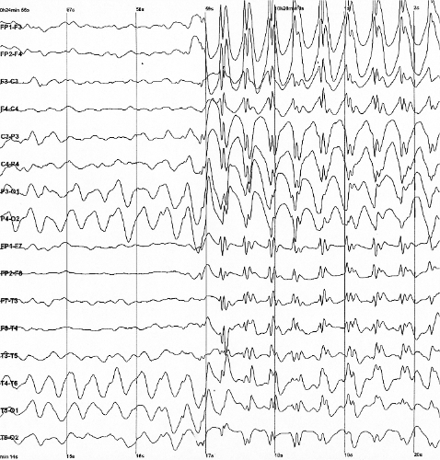
Unraveling the Brain
Different thoughts, actions, and mental states produce unique electrical patterns
These patterns are different for any given person
Figure 2 - Sample EEG output

Slide 8
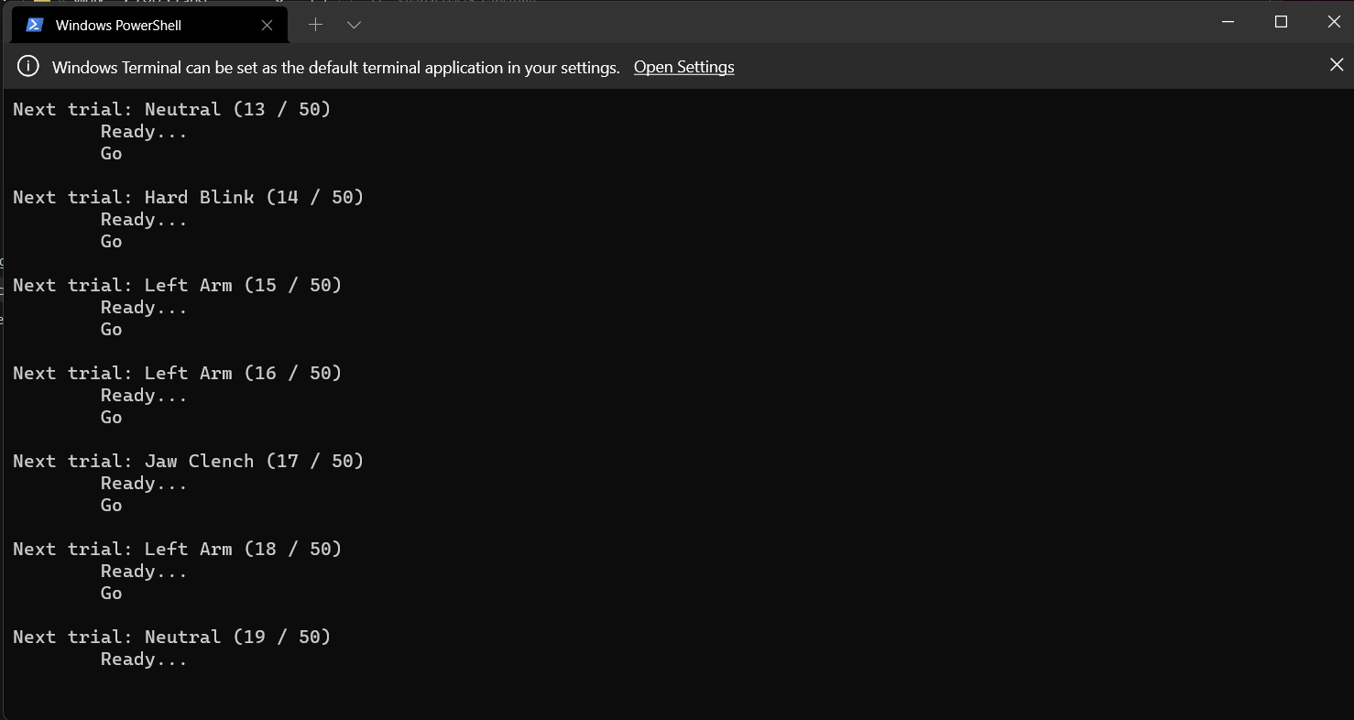
Building a Neural Fingerprint
The computer must be trained to recognize an individual’s unique patterns
Using machine learning (ML), the computer is taught to associate labeled patterns with commands
Figure 3 - Our calibration module collecting training data

Slide 9
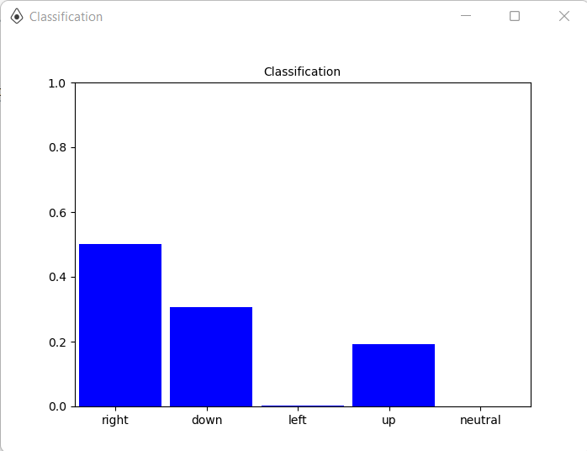
Command Classification
With enough examples, the ML model is able to classify subsequent patterns on its own
Using probability, it determines the command most likely to correspond to a given pattern
Figure 4 - A visualization of the ML model’s classification output

Slide 10
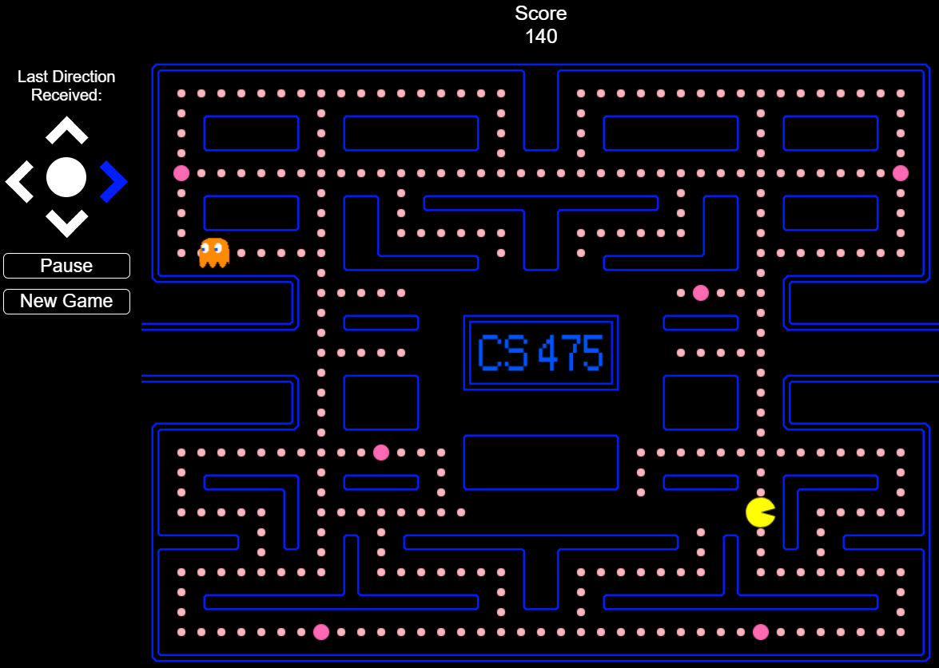
Playing the Game
The most likely command is sent to the game
The command is executed and Pac Man moves in the desired direction
Figure 5 - Pac Man in action

Slide 11
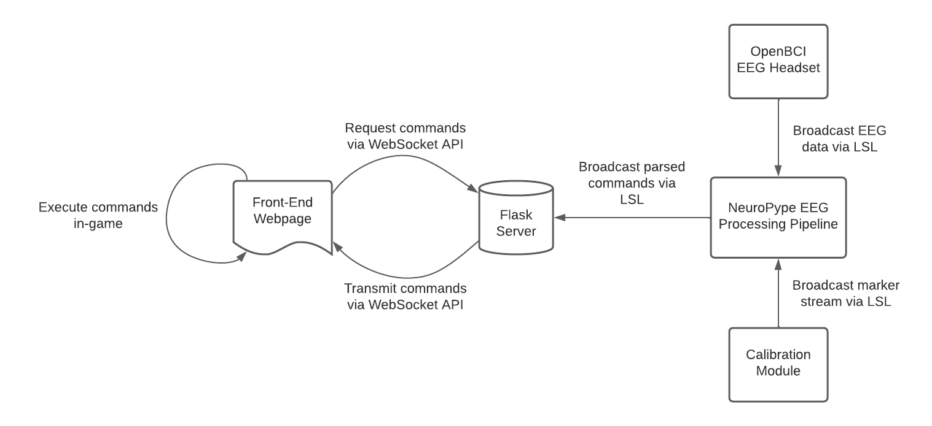
System Overview
Figure 6 - A diagram of the MindGames system architecture

Slide 12
System Overview - Communication
Lab Streaming Layer (LSL) - Synchronization and transmission of real-time continuous measurements
EEG data and training labels
WebSocket - Continuous communication between a webpage and a server
Game commands

Slide 13
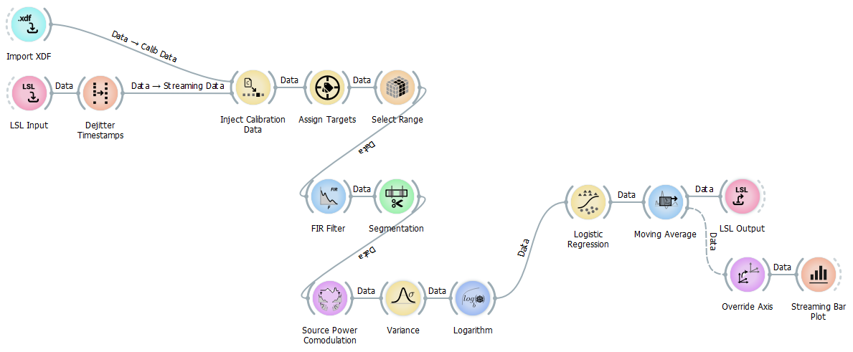
System Overview - Processing Pipeline
Figure 7 - The MindGames EEG processing pipeline

Slide 14
Processing Pipeline - Data Acquisition
Get EEG data and ML training labels into the pipeline
Assign training labels to commands
Figure 8 - EEG pipeline data acquisition component

Slide 15
Processing Pipeline - Preprocessing
Filter out electrical noise
Designate length of data “chunks” to associate with labels
Figure 9 - EEG pipeline preprocessing component

Slide 16
Processing Pipeline - Feature Extraction
Extract EEG signal components that exhibit the most variance between commands
Reduce the volume of data to make ML classification more efficient
Figure 10 - EEG pipeline feature extraction component

Slide 17
Processing Pipeline - Classification
Use extracted features to determine command probabilities
Maintain a moving average of probabilities to reduce noise
Output probabilities for further use
Figure 11 - EEG pipeline classification component

Slide 18
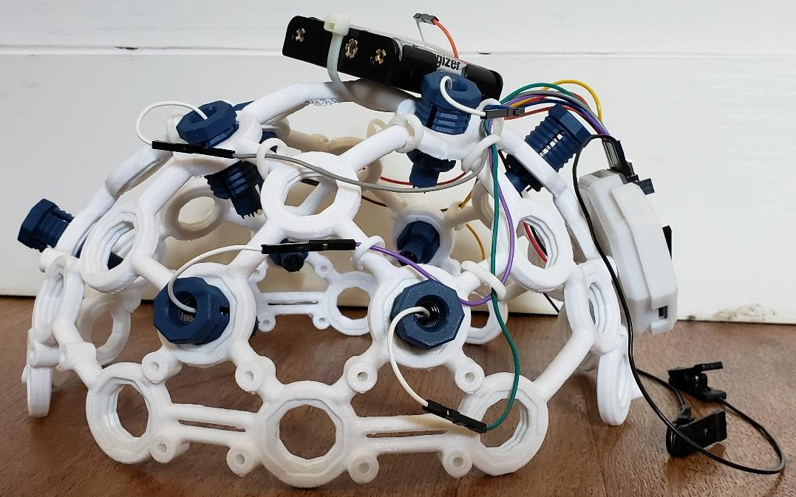
Challenges - Hardware
EEG data collected using OpenBCI Ultracortex headset
Difficult to secure, small movements cause it to shift position
Electrodes move with the headset, generating spikes and invalidating training data
Figure 12 - Ultracortex headset, profile view

Slide 19
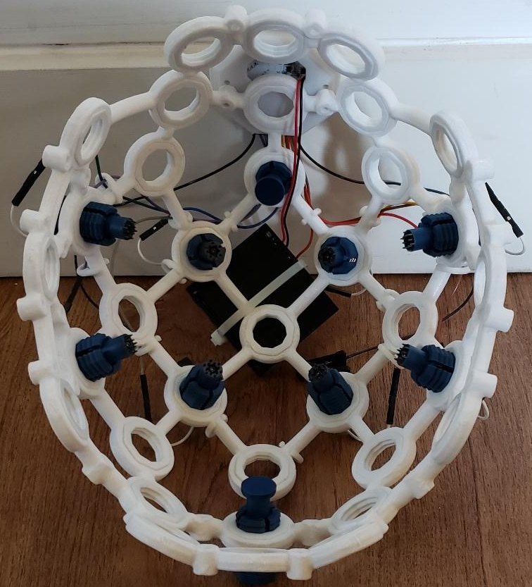
Challenges - Hardware
Limited to 8 electrodes (professional setups may use up to 128)
Electrodes are not secured to the scalp
RESULT: Low quality data (and not enough of it)
Figure 13 - Ultracortex headset, bottom view

Slide 20
Challenges - Software
ML training takes 8 minutes, results become useless as electrodes shift with headset
Noise and irrelevant spikes (e.g., blinking, swallowing) must be filtered out without affecting relevant signals
Everything must happen with minimal latency for the game to feel responsive

Slide 21
Next Steps
Fine-tune our noise reduction and ML classification techniques
Devise a system to secure the headset in place
Transition from classifying movements to classifying imagined movements (motor imagery)

Slide 22
Questions?

